Slide 1


Manual Testing Orangehrm.com Demo Project
Testing Team members
Aya Shanteer
Yousef Sabt
Hala Mousa
Bashir Rimawi
Ahmad Badaha
Teaching Team
Mr.Mamoun Sobh
Ms.Afnan Kharoof

Slide 2
OrangeHRM is a web-based Human Resource Management System. It helps companies manage employee information like personal details, job data, and documents.The system is used by both employees and HR to make HR tasks easier and faster.

Slide 3
Our Project combined from 5 phases we have divided each phase into tasks between team members :
Phase 1: Requirements Analysis. (All Team )
Phase 2: Test Plan.(Yousef Sabt , Hala Mousa)
Phase 3:Test Cases Design.(Admin module (Yousef , Hala , Aya) (Employee Module (Ess_User) (Ahmad , Bashir).
Phase 4:Test Execution.(Each team member execute their Test Cases and submit findings in bug report . Build (RTM)(Badaha,Bashir).
Phase 5:Test Summary (All Team Members).

Slide 4
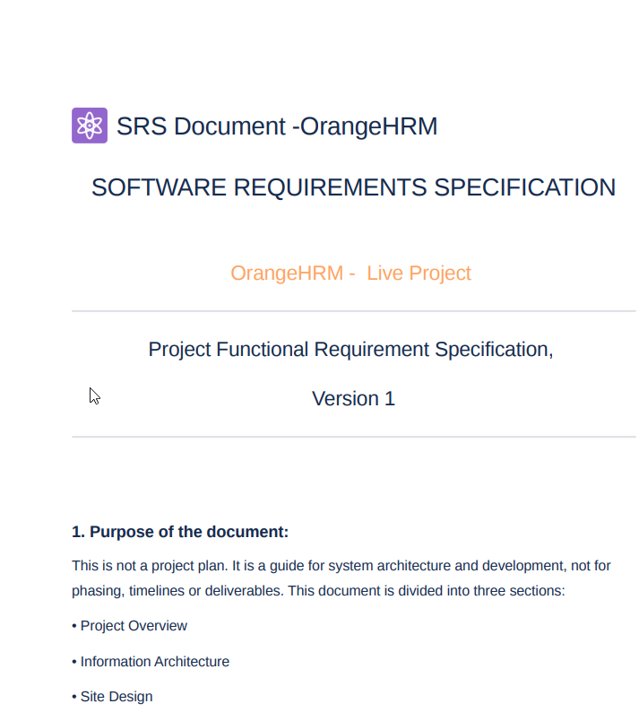
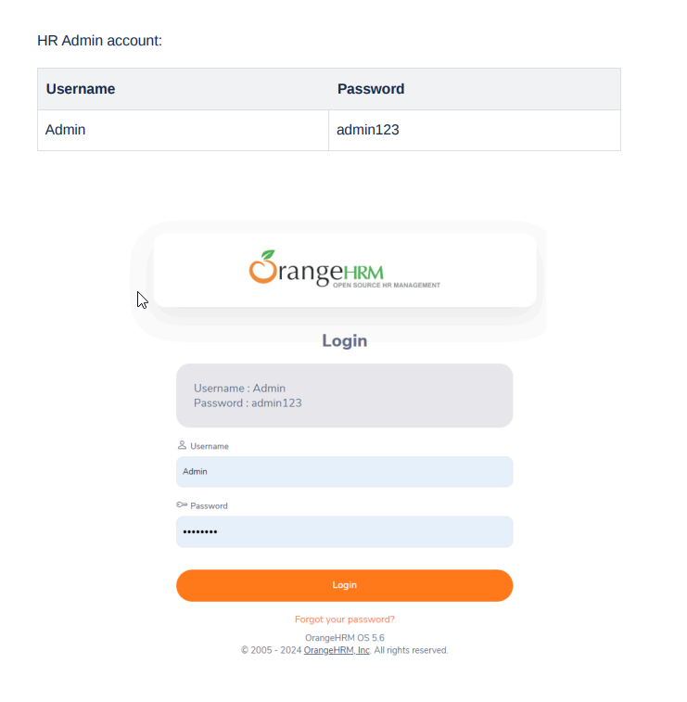
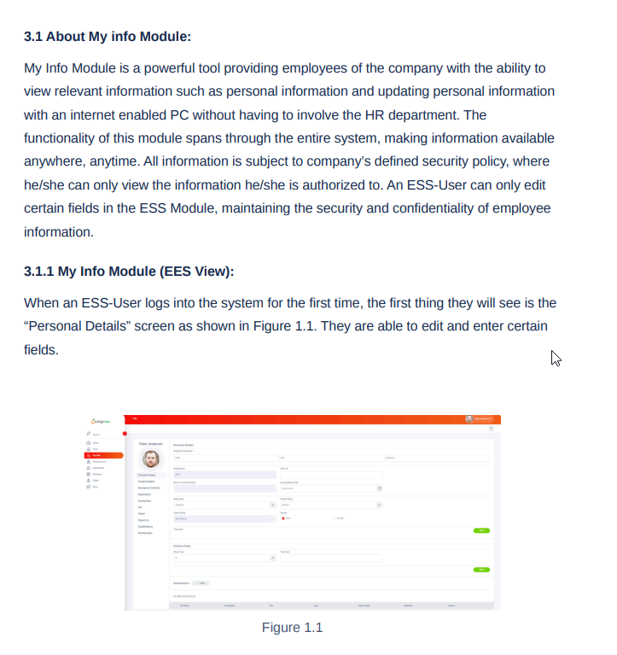

Phase 1: Requirements Analysis. (All Team )
SRS File

Slide 5
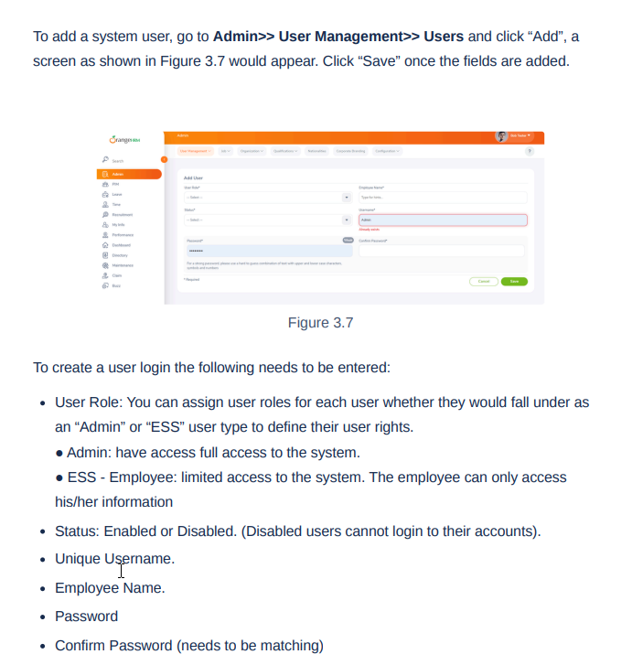
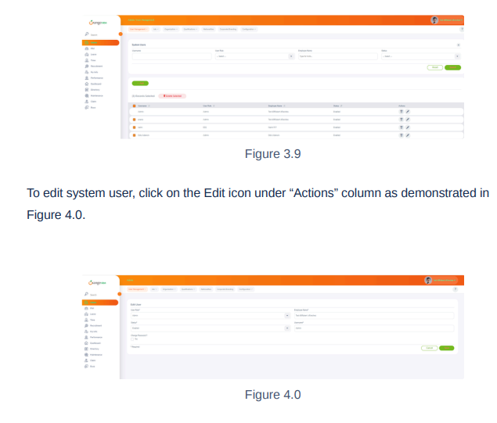
SRS File

Slide 6
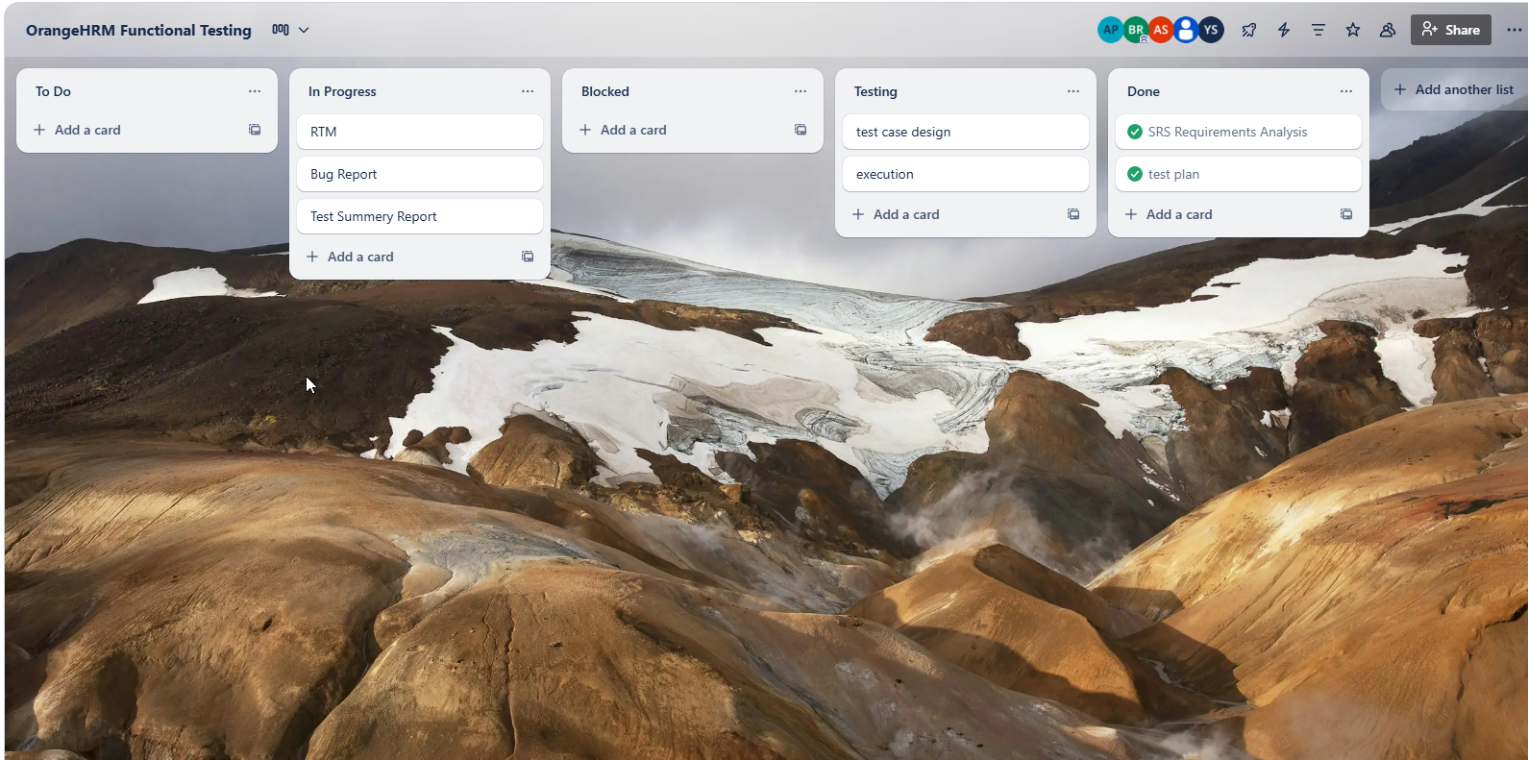
Trello Board To Track Our Progress
Trello Board

Slide 7
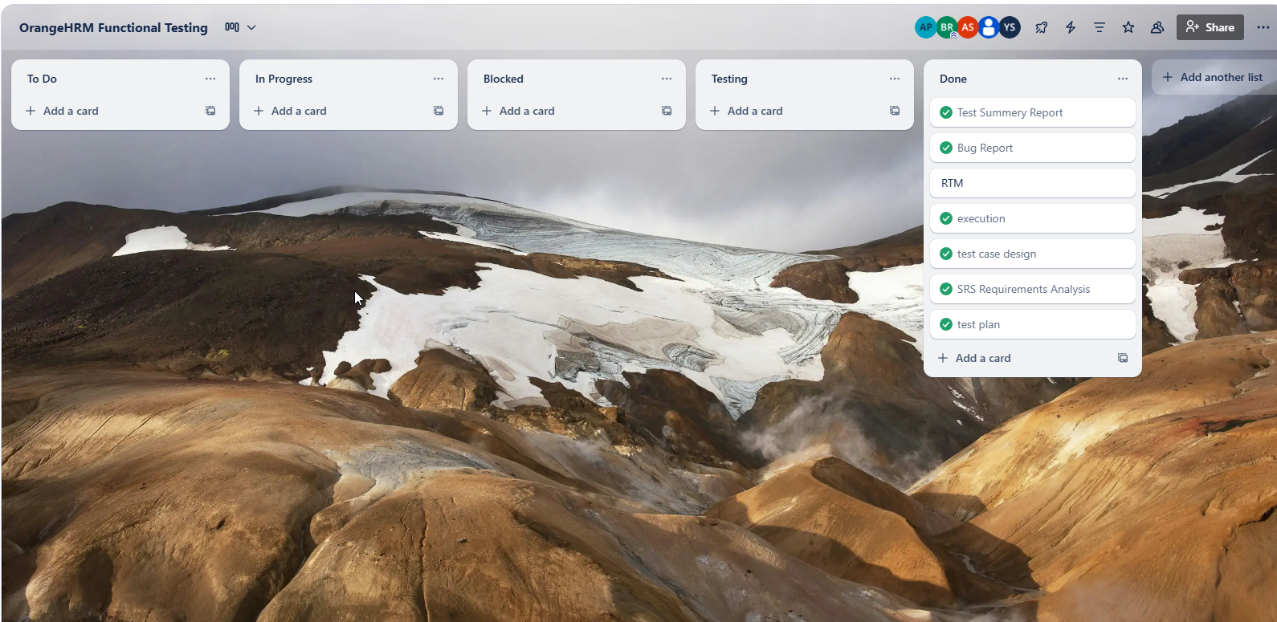
Trello Board To Track Our Progress
Trello Board

Slide 8

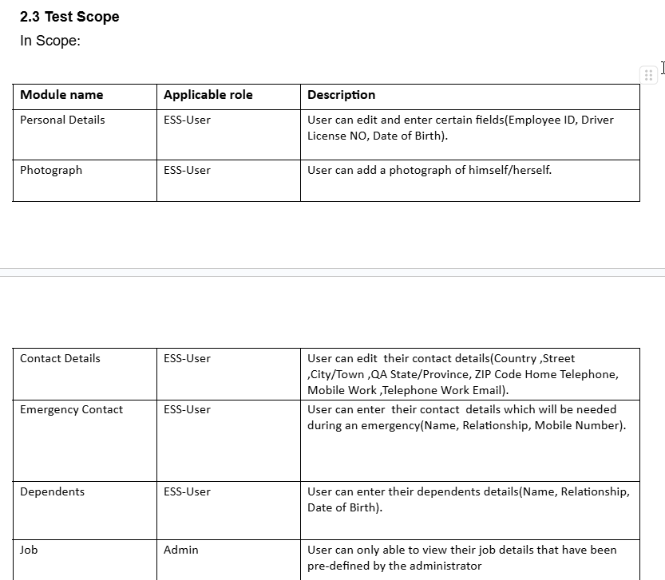
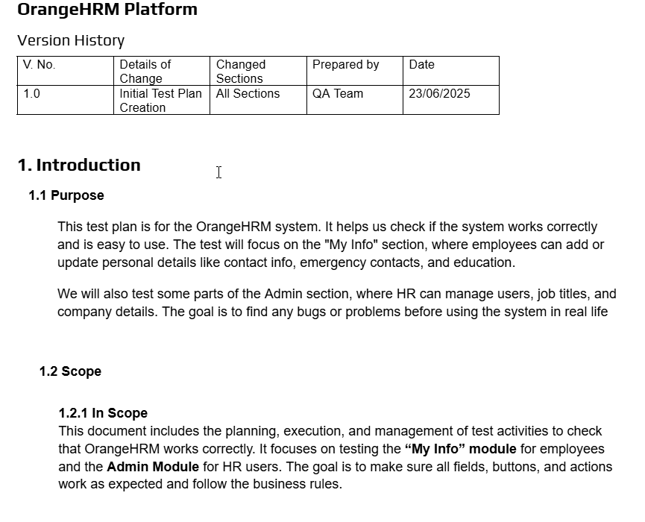
Phase 2: Test Plan.(Yousef Sabt , Hala Mousa)
Project Files

Slide 9

Phase 3: Test Cases Design
ESS-User Role Testing Team:
Bashir Rimawi
Ahmad Badaha
Admin Role Testing Team:
Aya Shanteer
Yousef Sabt
Hala Mousa
Test cases File

Slide 10
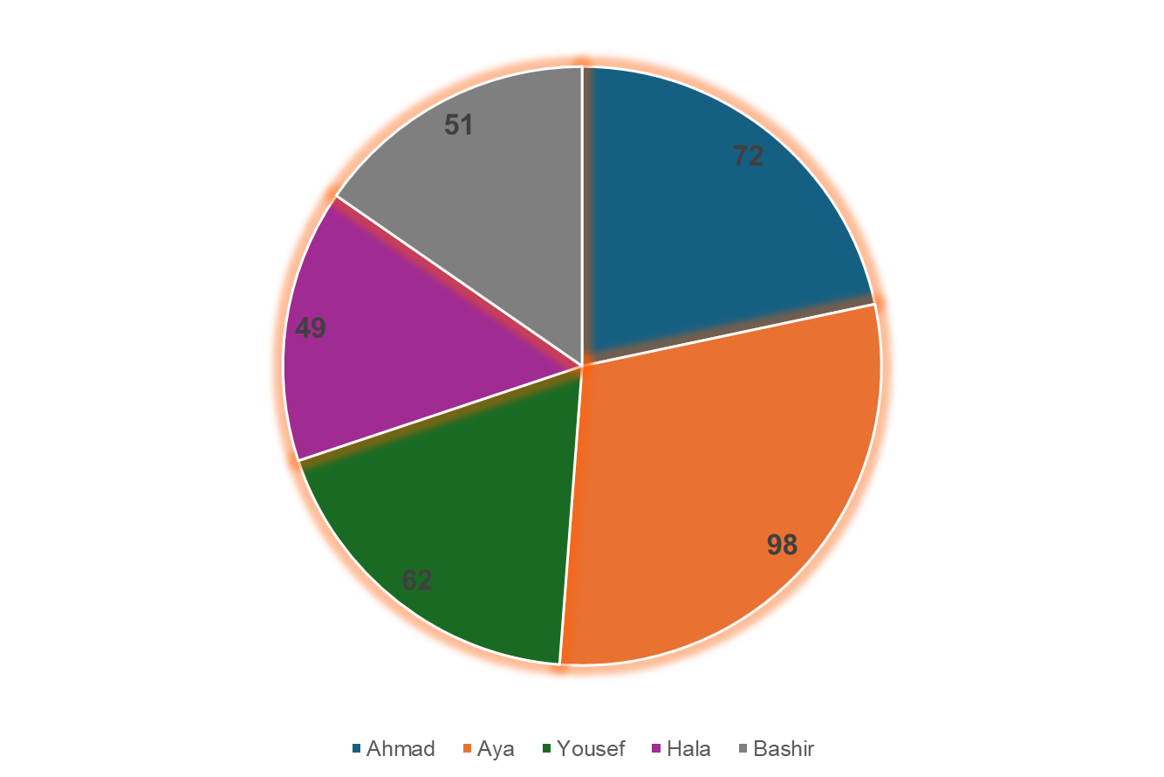
Phase 4: Test Execution
Total Number of Executed test cases: 331
Bashir Rimawi: 51
Ahmad Badaha: 71
Aya Shanteer: 98
Yousef Sabt: 62
Hala Mousa: 49
Test cases File
RTM File

Slide 11
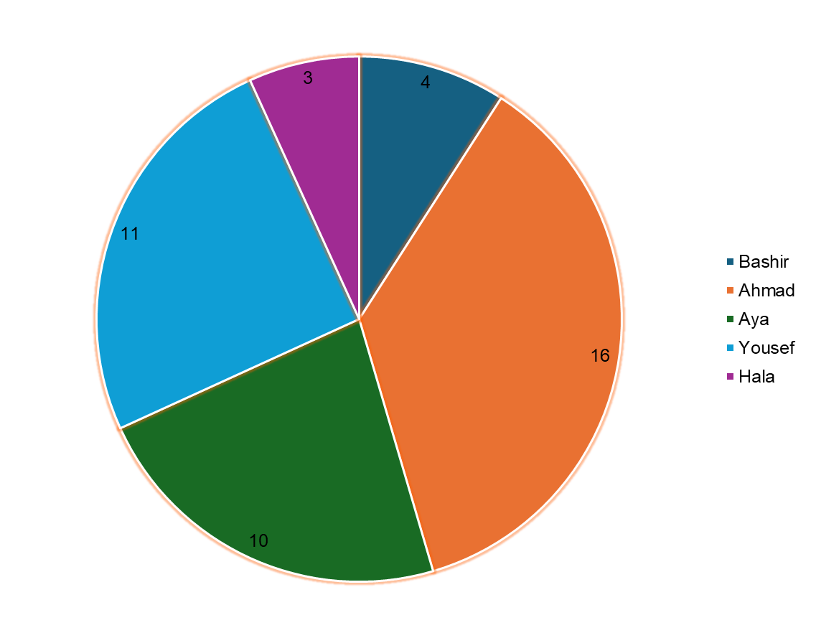
Phase 5: Test Summary
Total Number of found bugs: 44
Bashir Rimawi: 4
Ahmad Badaha: 16
Aya Shanteer: 10
Yousef Sabt: 11
Hala Mousa: 3
Bug Report File

Slide 12
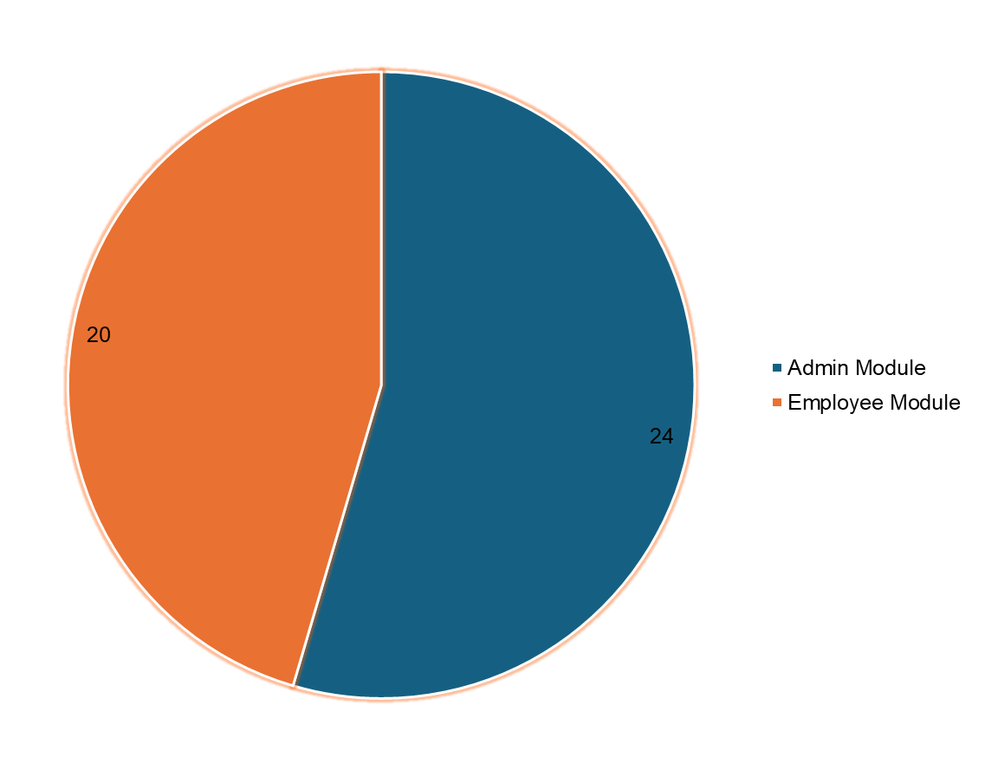
Bugs found in Admin & Employee Module
Admin Module : 24
Employee Module: 20
Test Summary Report

Slide 13
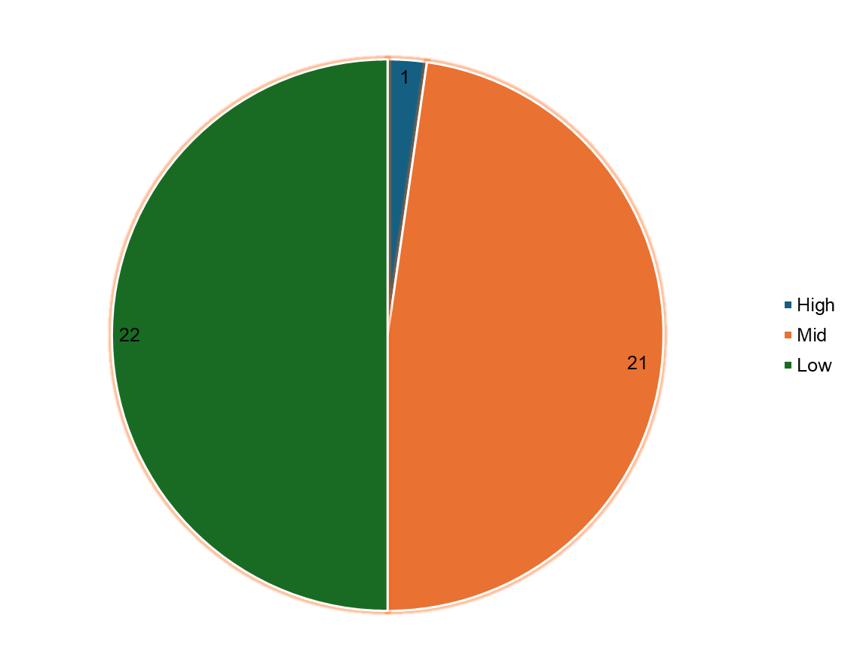
Severity of found bugs
High: 1
Mid: 21
Low: 22
Test Summary Report

Slide 14
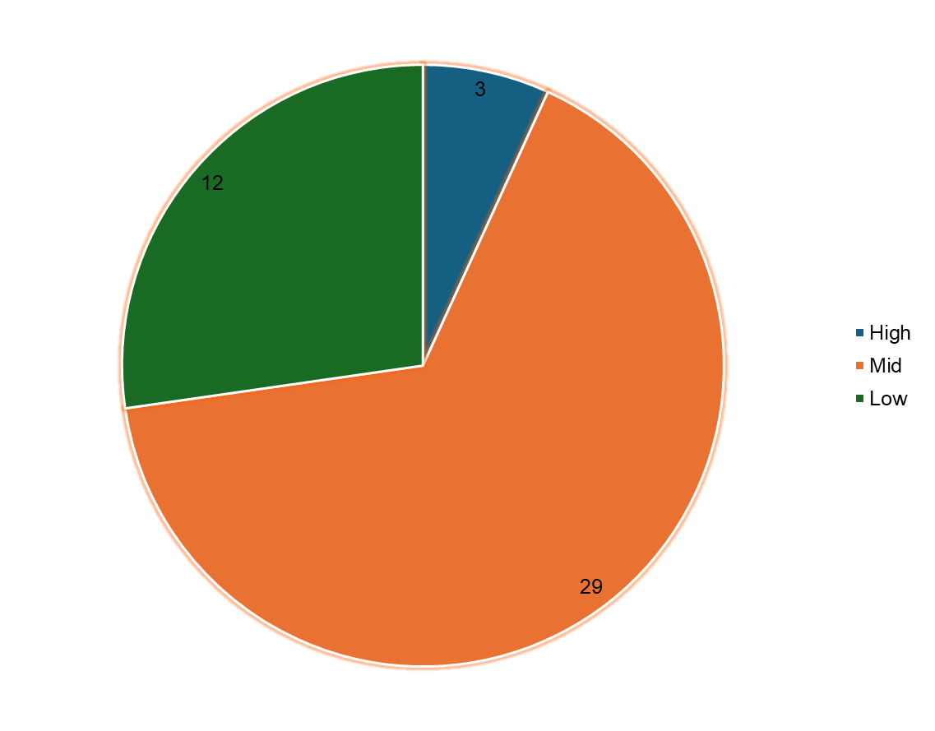
Priority of found bugs
High: 3
Mid: 29
Low: 12
Test Summary Report

Slide 15
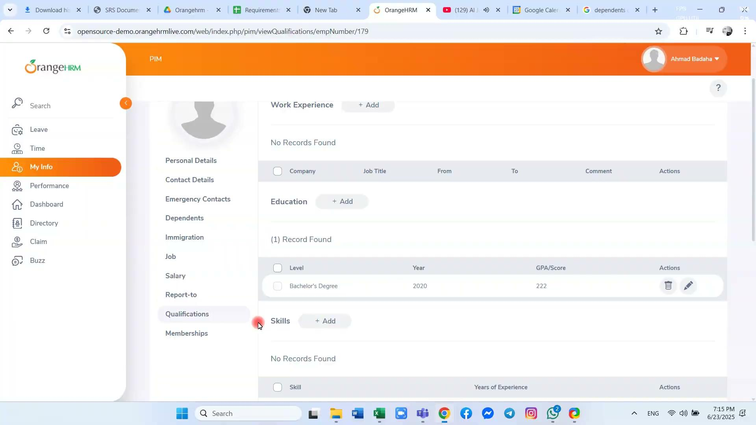
Examples of found Bugs
Found by: Ahmad
Summary: User cant delete record from Education section
severity: mid
Bug Report File

Slide 16
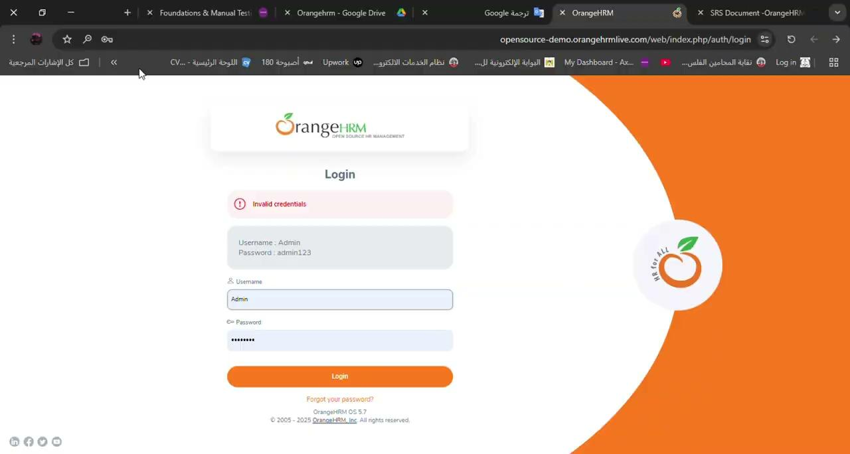
Examples of found Bugs
Found by: Yousef
Summary: Case-sensitive validation not applied on username field during login
severity: High
Bug Report File

Slide 17
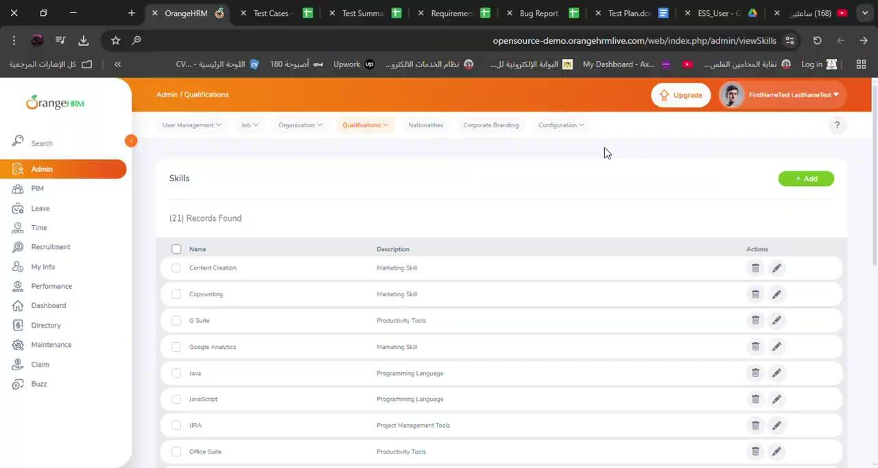
Examples of found Bugs
Found by: Aya
Summary: Admin can add a skill with special characters
severity: Mid
Bug Report File

Slide 18
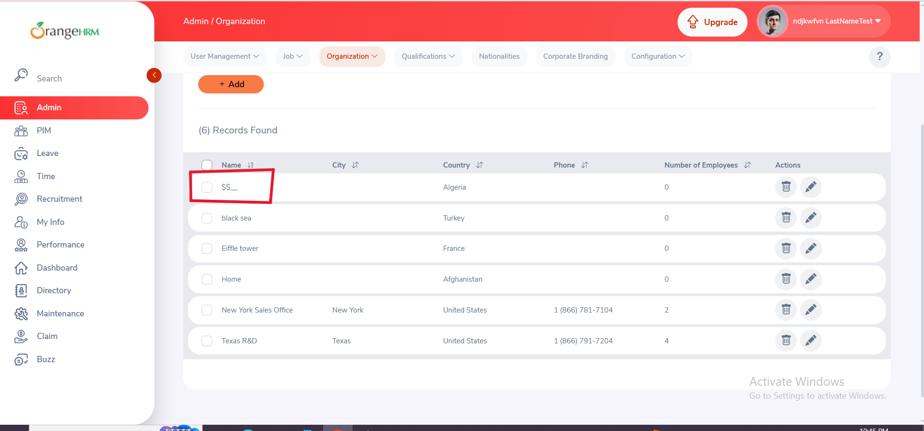
Examples of found Bugs
Found by: Hala
Summary: Admin can add invalid location name with special characters
severity: Mid
Bug Report File

